Slide 1
Chapter 14
Forging the National Economy

Slide 2
Westward Movement
America moving west
Emerson said: Europe stretches to the Alleghenies, America lies beyond

Slide 3
Young people/young country
1850, ½ country under 30
Restless, energetic, on move, Chicken legs

Slide 4
What was life like in West?
Grim
Poorly fed, ill clad, shanties, disease, depression, death and loneliness
Women suffered
No contact
Small cabins
Not a good life

Slide 5
Tough for men too
Wrestling, biting, eye gouging
“Self reliance:” Emerson
Rugged Individualism
Some help from neighbors

Slide 6
Shaping the Landscape
As people moved west there was a toll on land
Overplanted, burned out, over-trapped
Destruction of bison
Ecological Imperialism

Slide 7
Even though using nature, still respect it
Nationalism influenced appreciation, no one had it
Artists like Catlin
Painted Nature and Natives
Preservation: Led to Yellowstone

Slide 8
March of Millions
Population doubling every 25 years
1860 33 stars
4th most populous country in world
Cities on grow
Some byproducts of growth
Slums, unsafe, no lights bad water, sewage, Hogs in the streets!
Some cities start to pipe water in, eliminated malaria without knowing

Slide 9
How did population change?
High Birthrate and Immigration
Where did they come from?

Slide 10
Irish
Germans

Slide 11
https://www.youtube.com/watch?v=vEz5mS_XQcQ
Ireland
1840’s
Potato famine
https://www.youtube.com/watch?v=erhWB33ERo0
Most ended up in cities
https://www.youtube.com/watch?v=e5uBItUHi1s
Many lived in slum like conditions
Biddies and Paddies
NINA
Fight Af/Ams for jobs
Secret societies to protect each other AOH or unions: Molly Maguire's
https://www.youtube.com/watch?v=w_6_gvxlWTQ
Strove for property ownership
Many found their way into city politics

Slide 12
Germans
Came 1830s-60s
Uprooted farmers and political refugees
Brought with them certain ideas like Conestoga wagon, Kindergarten, Kentucky rifle
Not always accepted, some issues with drinking on Sundays

Slide 13
Anti-foreignism
Nativists rear head
Said immigrants took their jobs
Commented on drinking
Order of the Star Spangled Banner: Developed into Know Nothings
Literature: Evil doings of Catholics
Violence to schools and churches

Slide 14
March of Mechanization
1750s Industrial Revolution starts in England
Steam powered mills
Took a while to get to US

Slide 15
Creeping Mechanization
Use your Cornell notes and page 297 in your book to make a list of 7 reasons why mechanization was slow to the US

Slide 16
Why so slow to US?
1. Land was cheap, so farm
2. labor scarce at first
3. money for capital needed
4. Raw materials underdeveloped
5. Consumers scarce
6. superior British Goods
7. monopoly of machinery by British

Slide 17
Mechanical Minds
Samuel Slater memorizes plans and comes to US
Whitney introduces Interchangeable parts, cotton gin
Invigorated slavery
N and S profited from Slavery
Why NE for mills? Rivers, bad soil, shipping

Slide 18
Marvels in Manufacturing
American factories slow till embargo of 1807
Buy American wear American!
After 1812, mills start closing
1816 tariff 1st to combat this
Interchangeable parts becomes widely accepted

Slide 19
Other inventions
Sewing Machine:
Howe 1846
Singer perfected
New ideas in Corporations
Limited Liability: Only lose what put in to business
Morse: Telegraph

Slide 20
Workers and Wage Slaves
Lost personal touch of apprentice/master
Child workers, pre 1820 half of labor force under 10
Adult wage earners, males did better with vote

Slide 21
Ideals of democracy led to workingmen’s parties
Employers fought parties and fought worker’s rights
1840 Van Buren gives Fed workers 10 hour day and sets model
Strikes begin in 30s/40s
Better times/weaker unions
Commonwealth v. Hunt
Unions legal if not devious

Slide 22
Women and Family
6 day work weeks
Lowell MA
Mostly domestic or stereotypical
Teaching
Single
Cult of Domesticity/Women’s sphere
Domestic feminism
Child centered/smaller families
Shape child not break child
Independent thinking

Slide 23
Western Farmers
Ohio and Indiana were Bread Basket
Cinci, meat processing
Needed better transport
Used rivers
Tough soil in W
McCormick Reaper/Deer Plow
Farmers become capitalists

Slide 24
Highways and Steamboats
Slow transportation
Could take 6 months for 60 miles
1790 Lancaster turnpike
Problems with roads:
Roads expensive, states rights, road went west and took people, made East mad
1811 Cumberland Road: National Road to Maryland to Ill

Slide 25
Steamboats:
1807 Clermont: Fulton’s folly
10 mi an hour
Canals
Erie
Clinton digs his own ditch
1817-1825
100 to 5 dollars for ton of grain
20 days to 6
New cities and states

Slide 26
Railroad
1828 1st rr
1860 30000 miles
Not favored first, but eventually won over
NY 1833 prohibited RR
Dangerous, sparks, crash , brakes, gauge , transfers

Slide 27
Transportation binds the union
Brought E and W together
Previous w had traded with S
Created continental economy
Helped in war
S slow to build transport lines
Specialized economy developed

Slide 28
Wealth and Poverty
Many benefitted but rich and poor sep. grew
Cities greatest splits
Social mobility a myth
Better then other places possibilities
Innovations
Needed to communicate with Brit. Cyrus Field linked Brit and US
Clipper ships
Pony Express

Slide 29
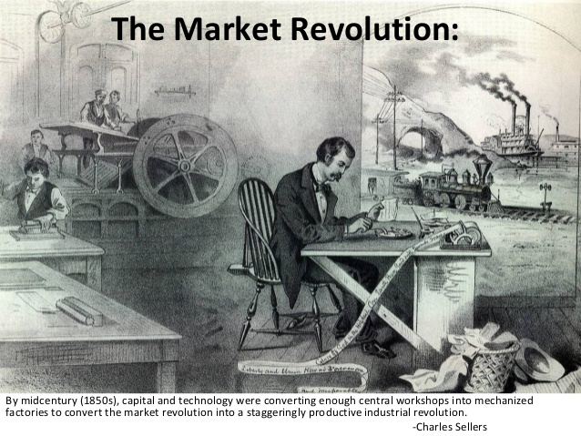
Market Revolution
End of the subsistence farmer
End of apprenticeship
Buying instead of making
Building of roads for goods
Wages up so people not noticing issues

Slide 30
Good and bad
Millionaires on rise
Increased prosperity
More chances here than anywhere
Wages did go up
Inequality in cities
Jobless, wandering workers
Was America the land of social mobility?

